Slide 1

Storms & Land
Cathy Hohenegger,
Chiel van Heerwaarden,
Sarah Warnau, Menno Veerman,
Edgar Dolores Tesillos, Junhong Lee,
Jonathan Wille, Kerstin Haslehner,
Josh Duffield, Lukas Brunner,
Emanuel Dutra
Hackathon Hamburg 2024

Slide 2
Cycle 3 results

Slide 3
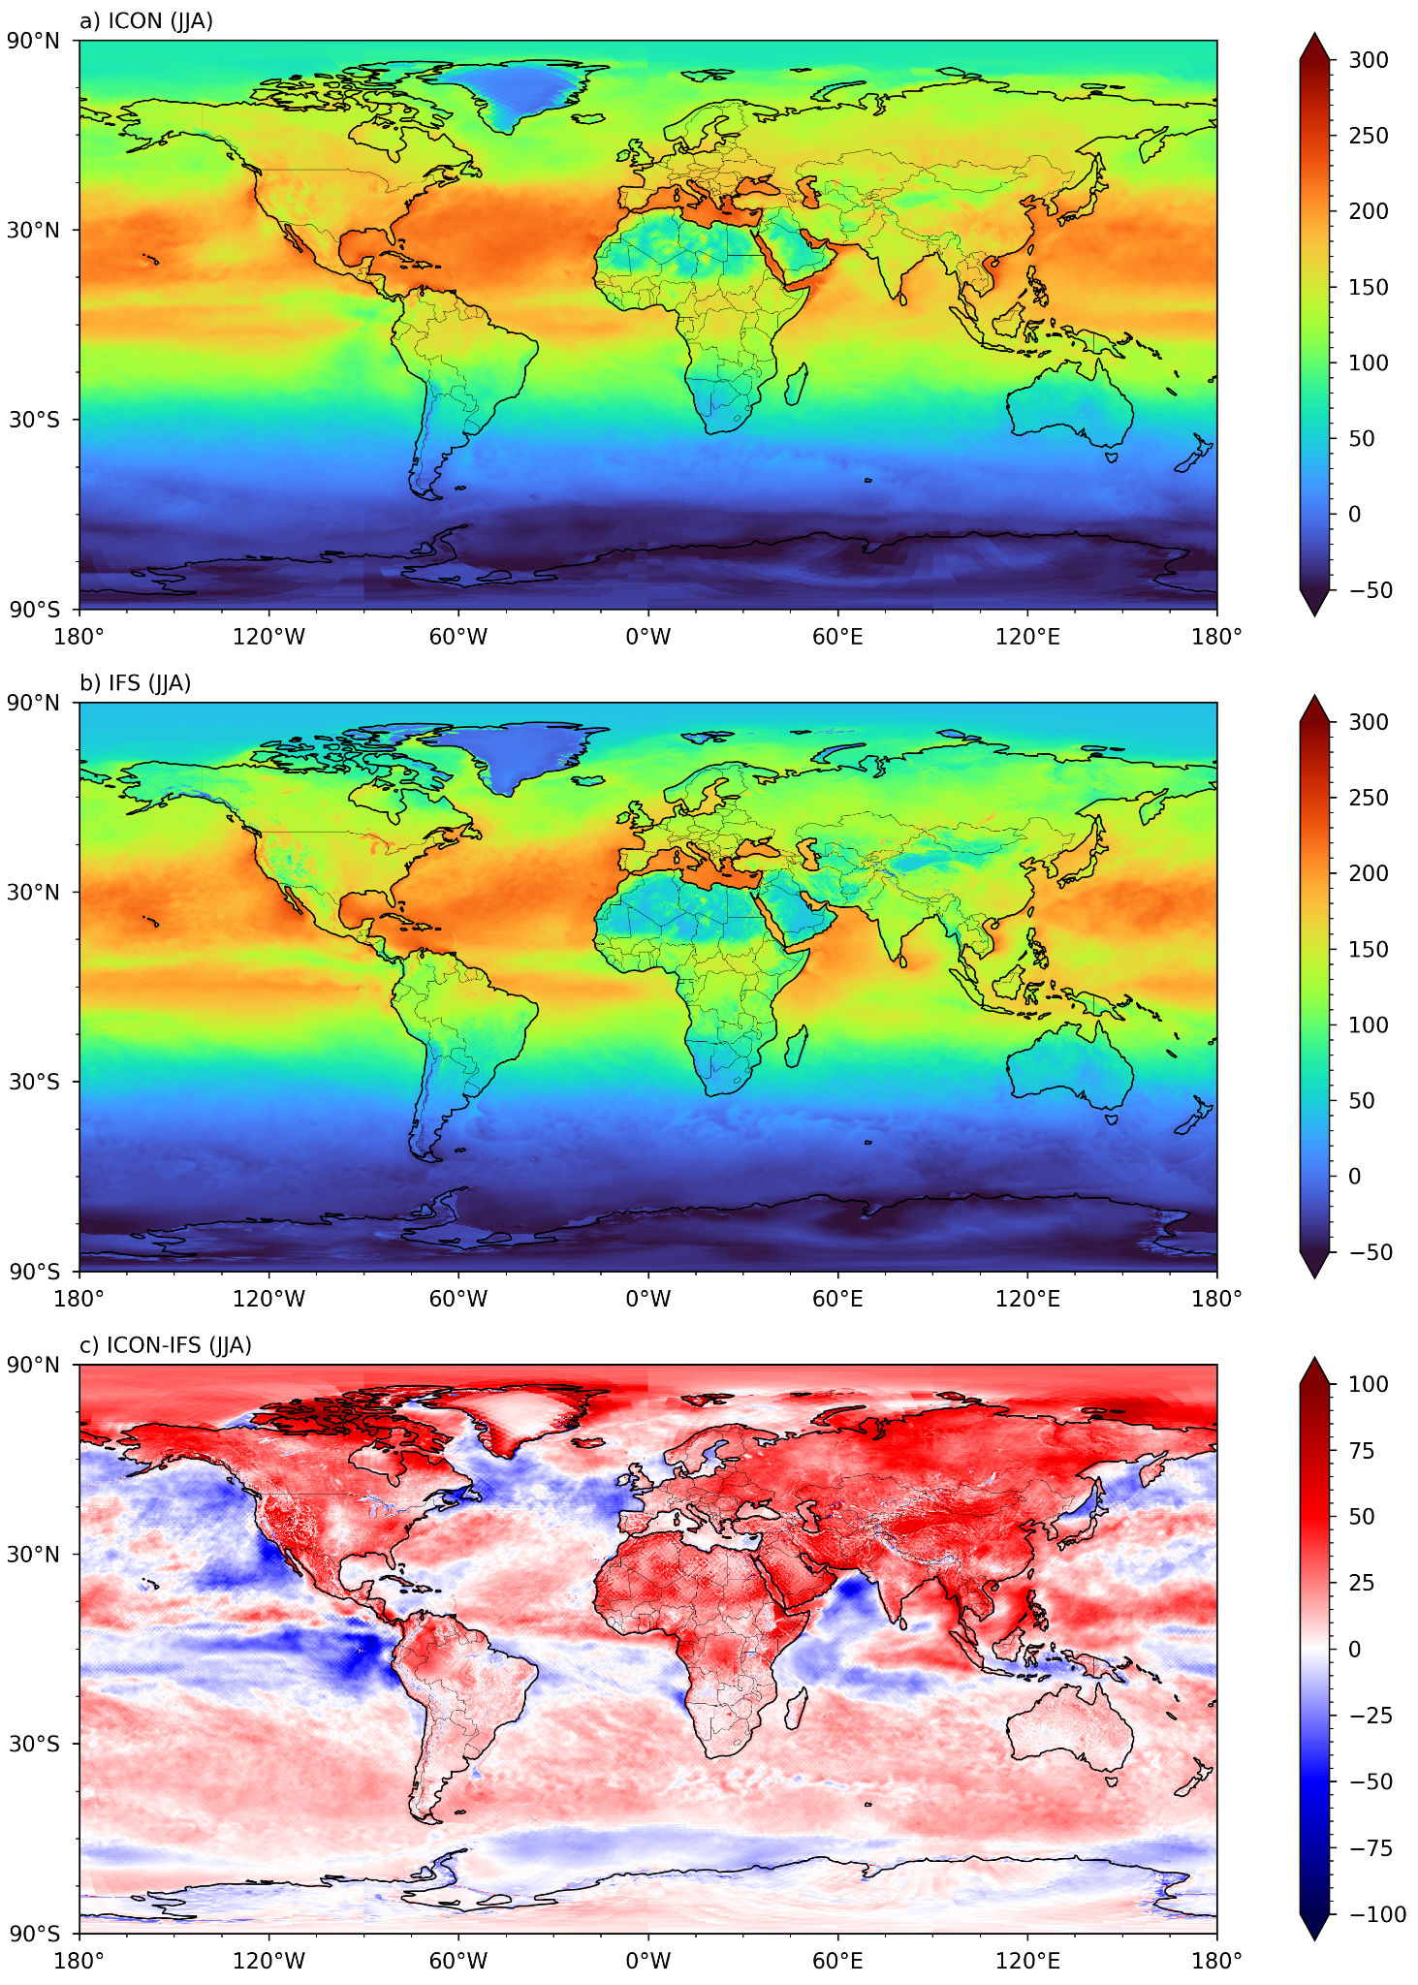
Cycle 3 Surface Net Radiation (Wm-2) JJA
ICON
ICON - IFS 4.4
IFS 4.4

Slide 4
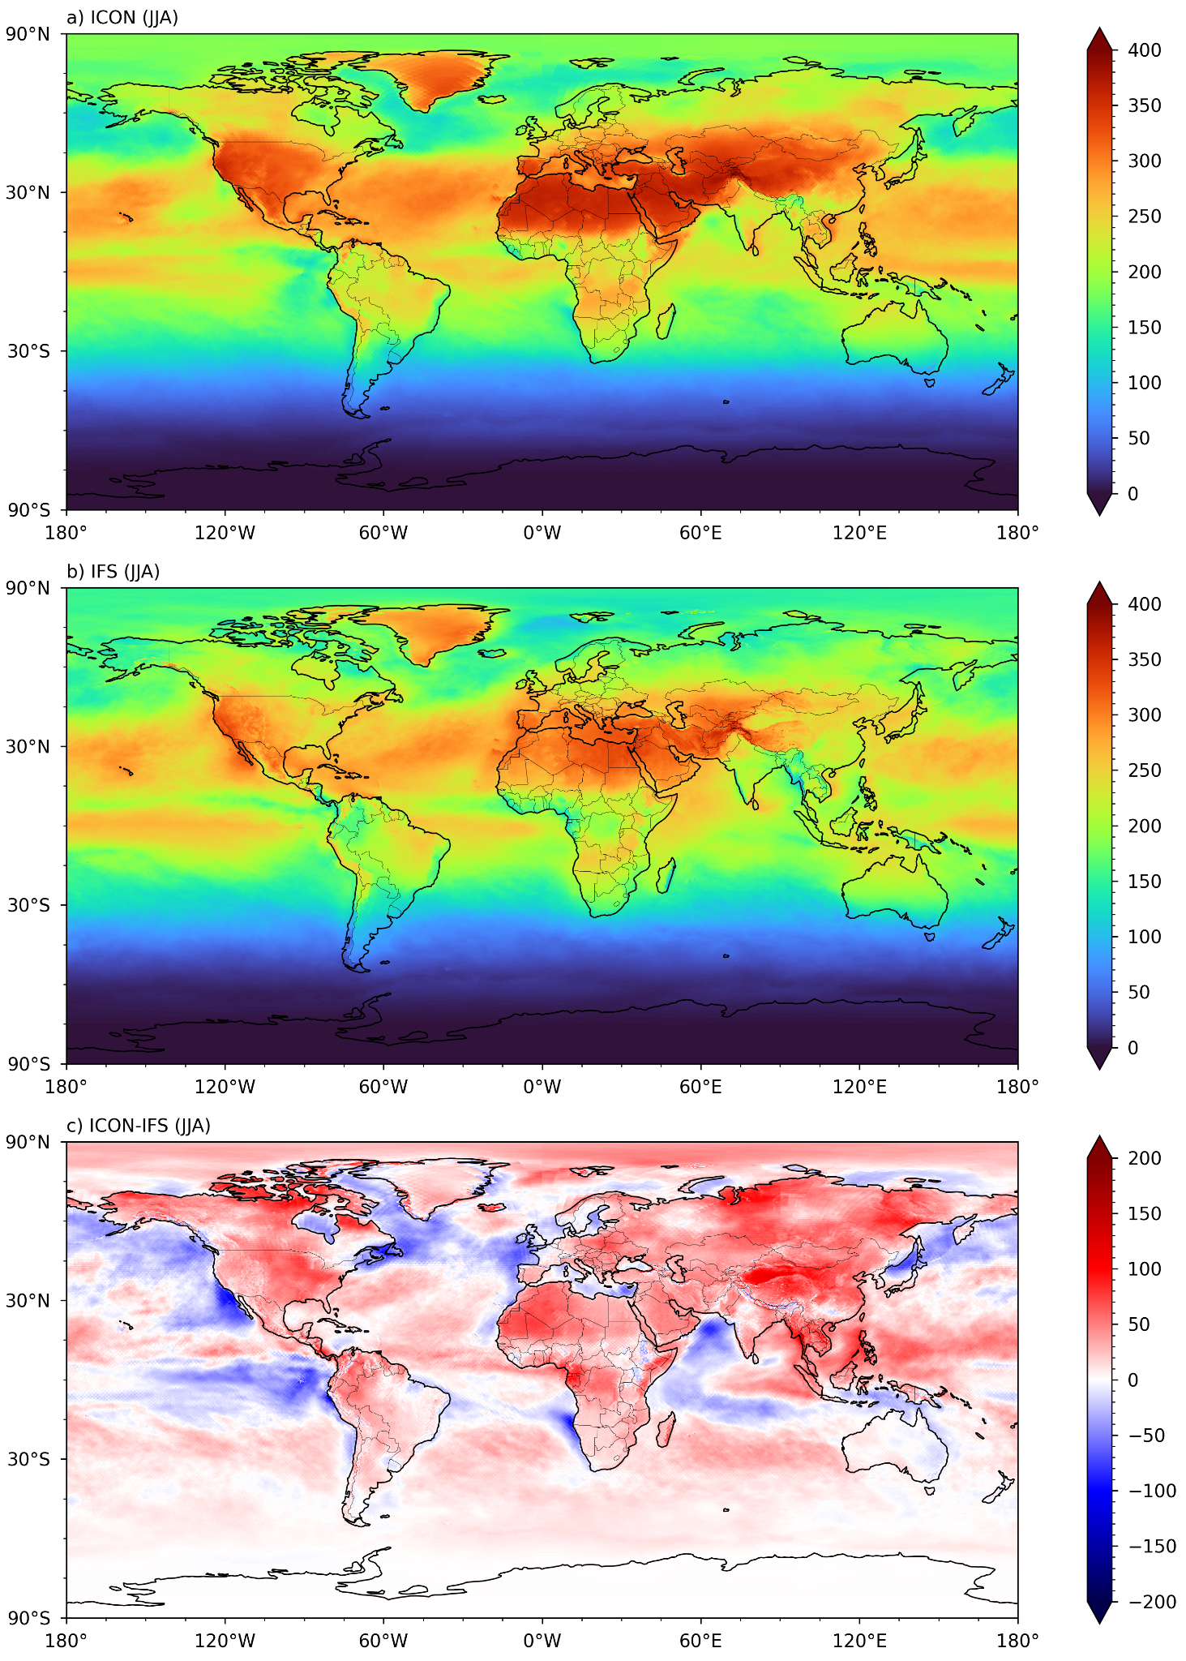
Cycle 3 Shortwave Down (Wm-2) JJA
ICON
ICON - IFS 4.4
IFS 4.4

Slide 5
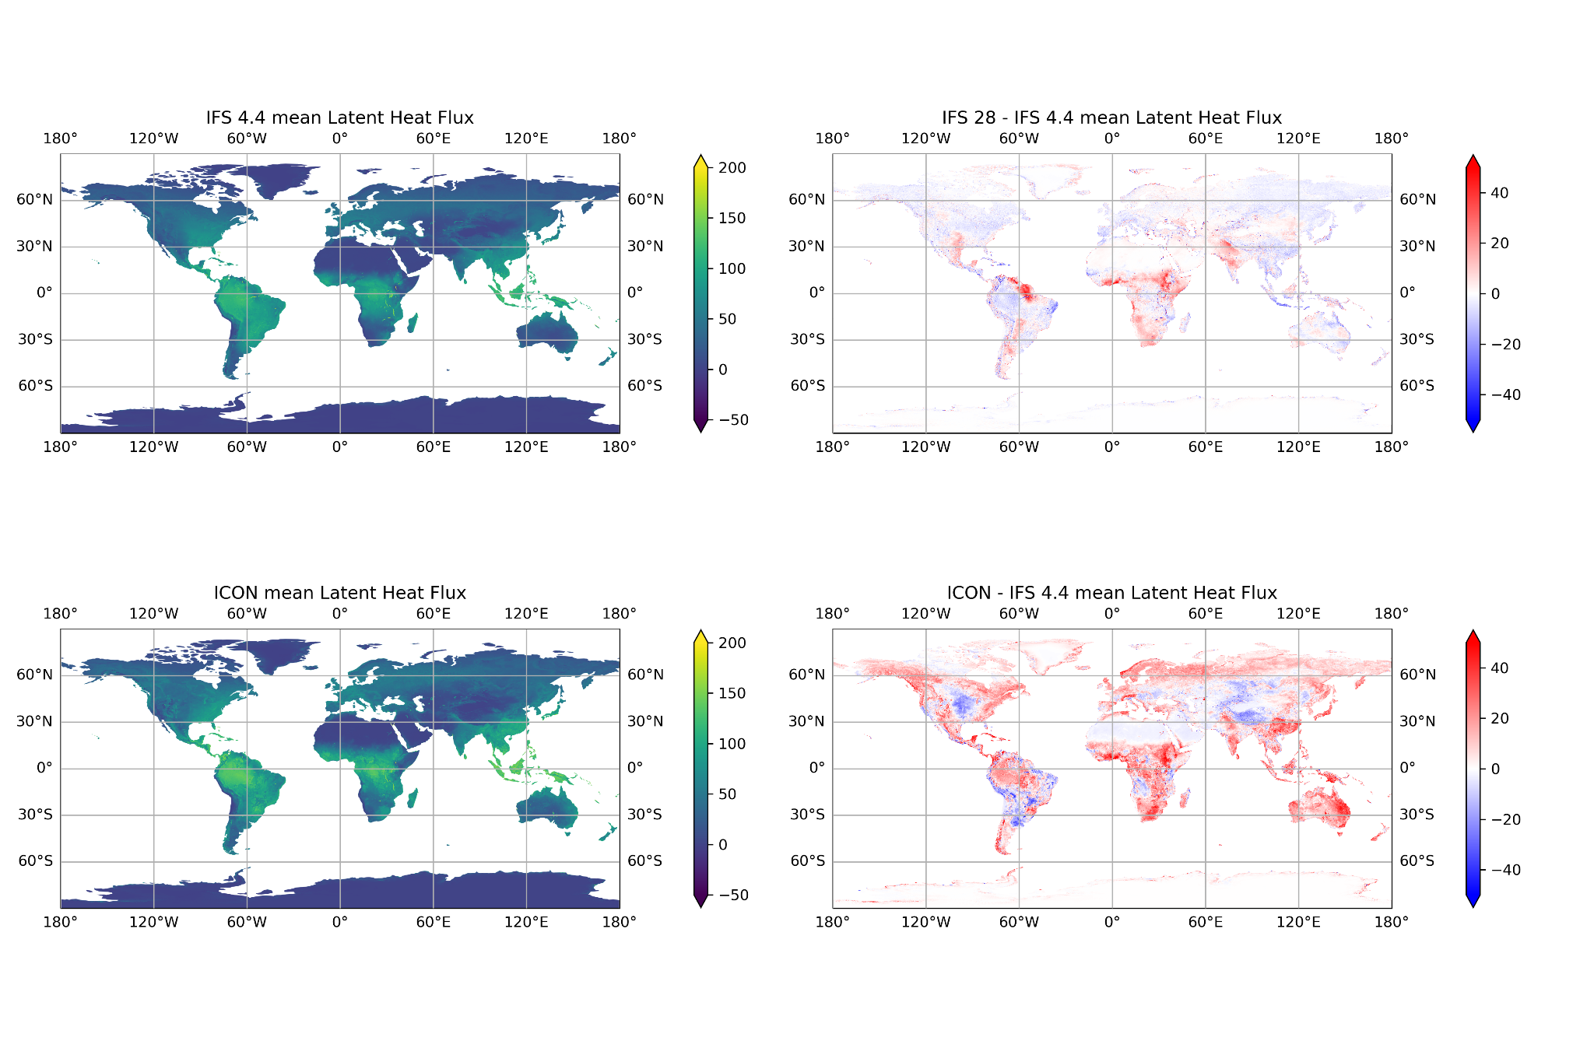
Cycle 3 5 year mean Latent Heat Flux (Wm-2)
IFS 4.4
IFS 28 - IFS 4.4
ICON
ICON - IFS 4.4
Notes:
The extra energy goes partly into extra latent heat, mostly in sub saharan Africa and Australia

Slide 6
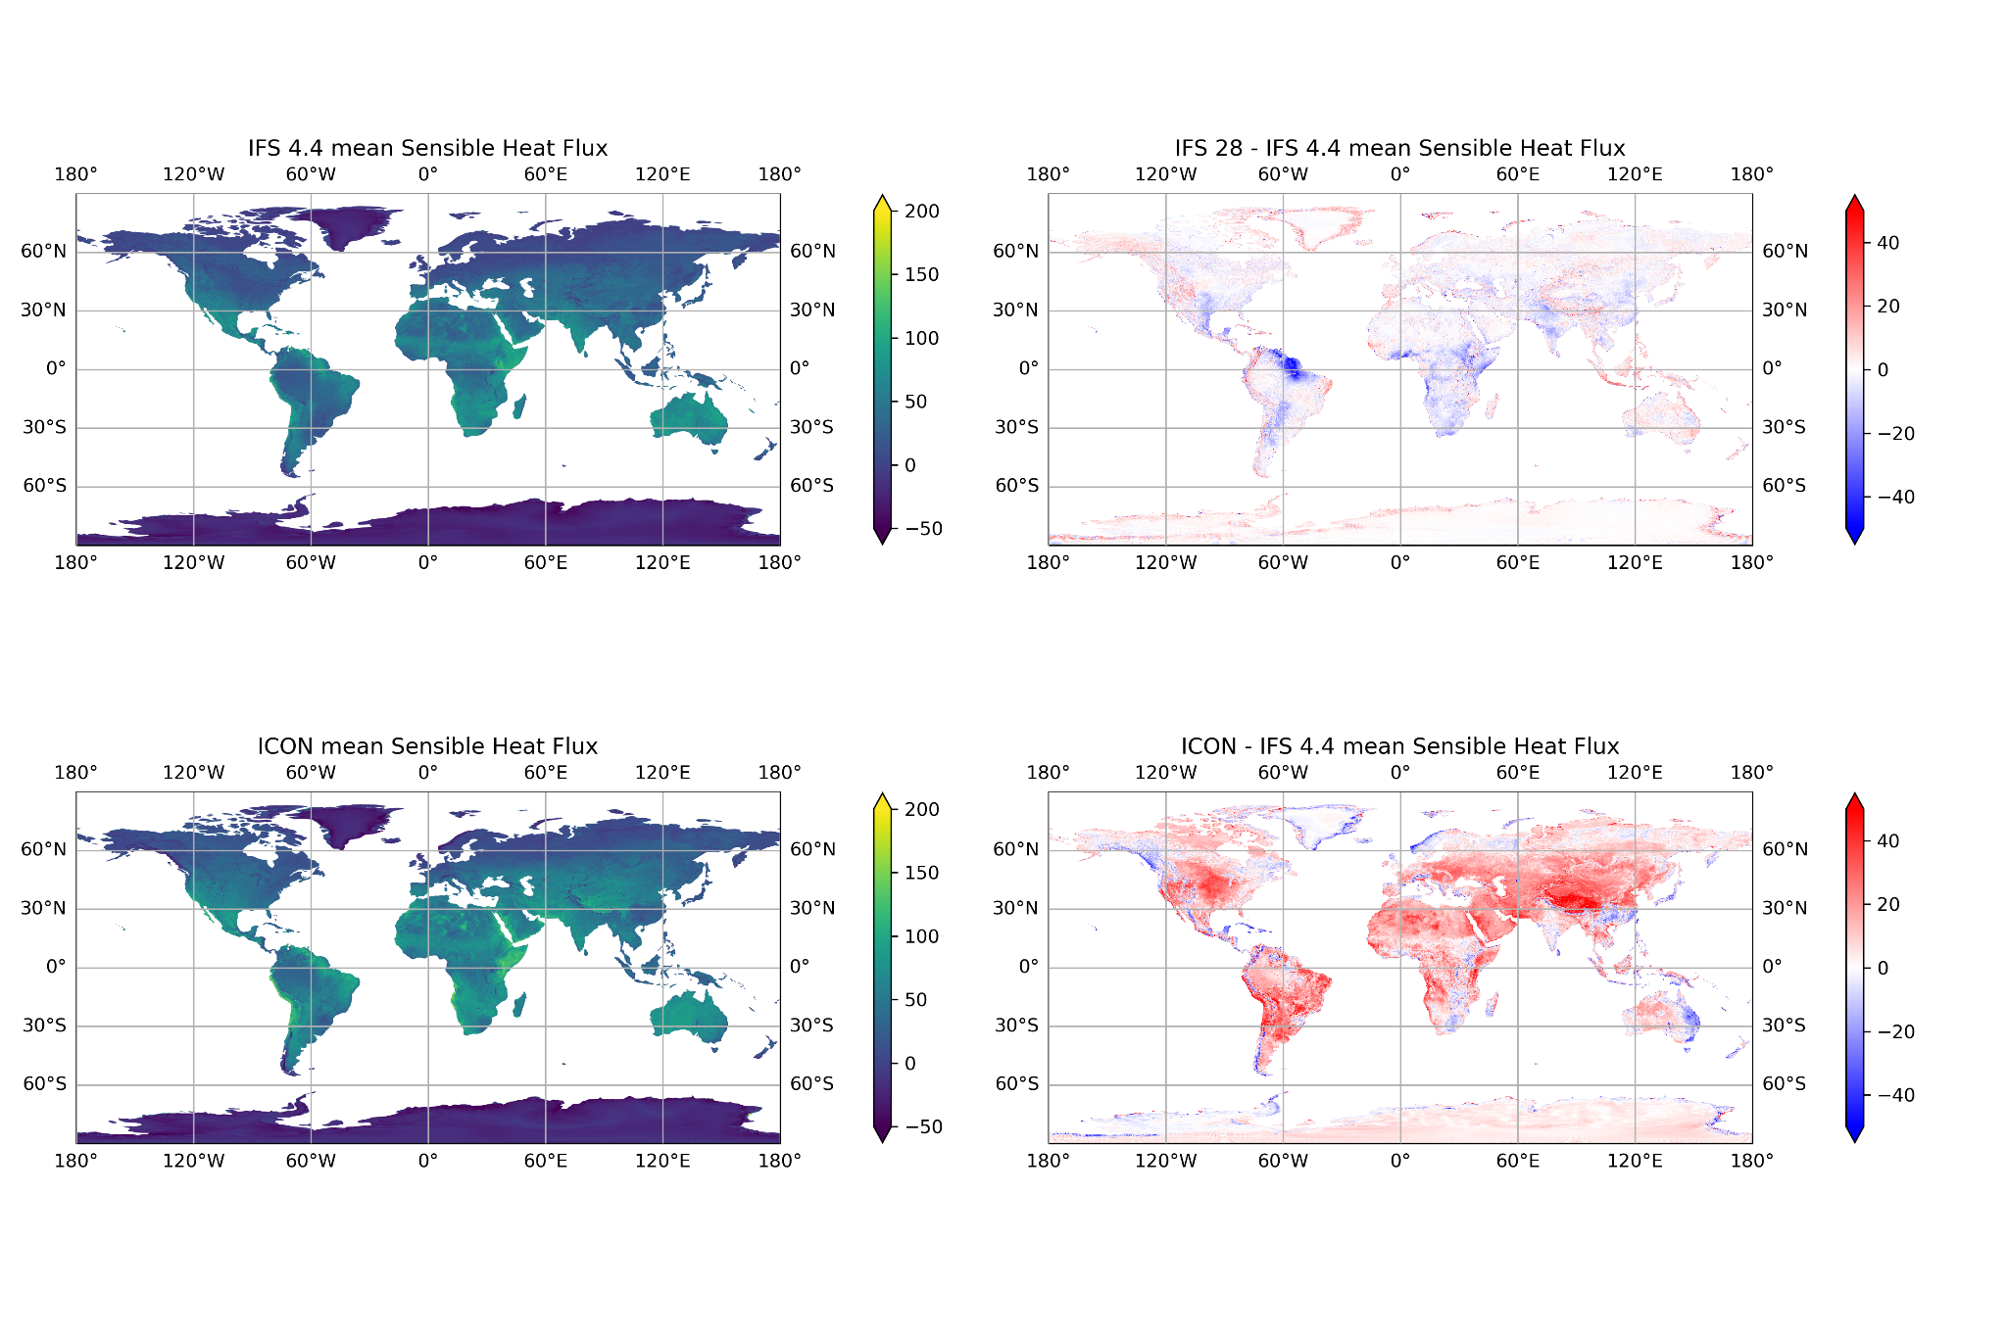
Cycle 3 5 year mean Sensible Heat Flux (Wm-2)
IFS 4.4
IFS 28 - IFS 4.4
ICON
ICON - IFS 4.4
Notes:
The extra energy goes largely into the sensible heat flux.

Slide 7
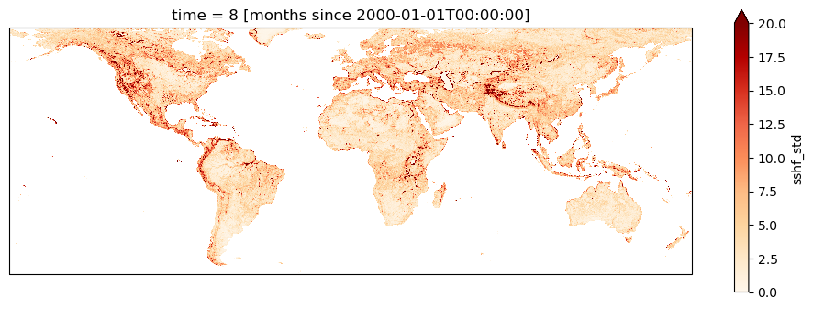
JJA sub-grid variability (on a 0.25x0.25 grid) of
Sensible Heat Flux (W.m-2) in IFS 4.4 km simulation
Notes:
Possible interpretation: areas where high resolution is relevant form a land surface perspective

Slide 8
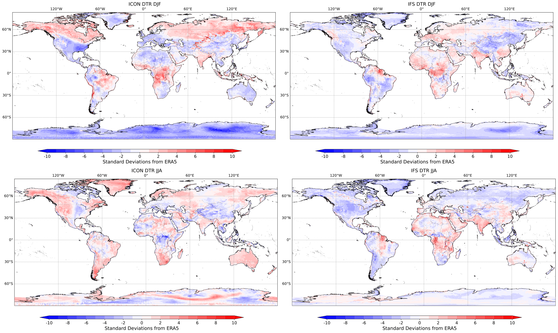
Differences in diurnal temperature range between IFS 4.4/ICON and ERA-5 for DJF (top row) and JJA (bottom row)
IFS (DJF)
ICON (DJF)
IFS (JJA)
ICON (JJA)

Slide 9
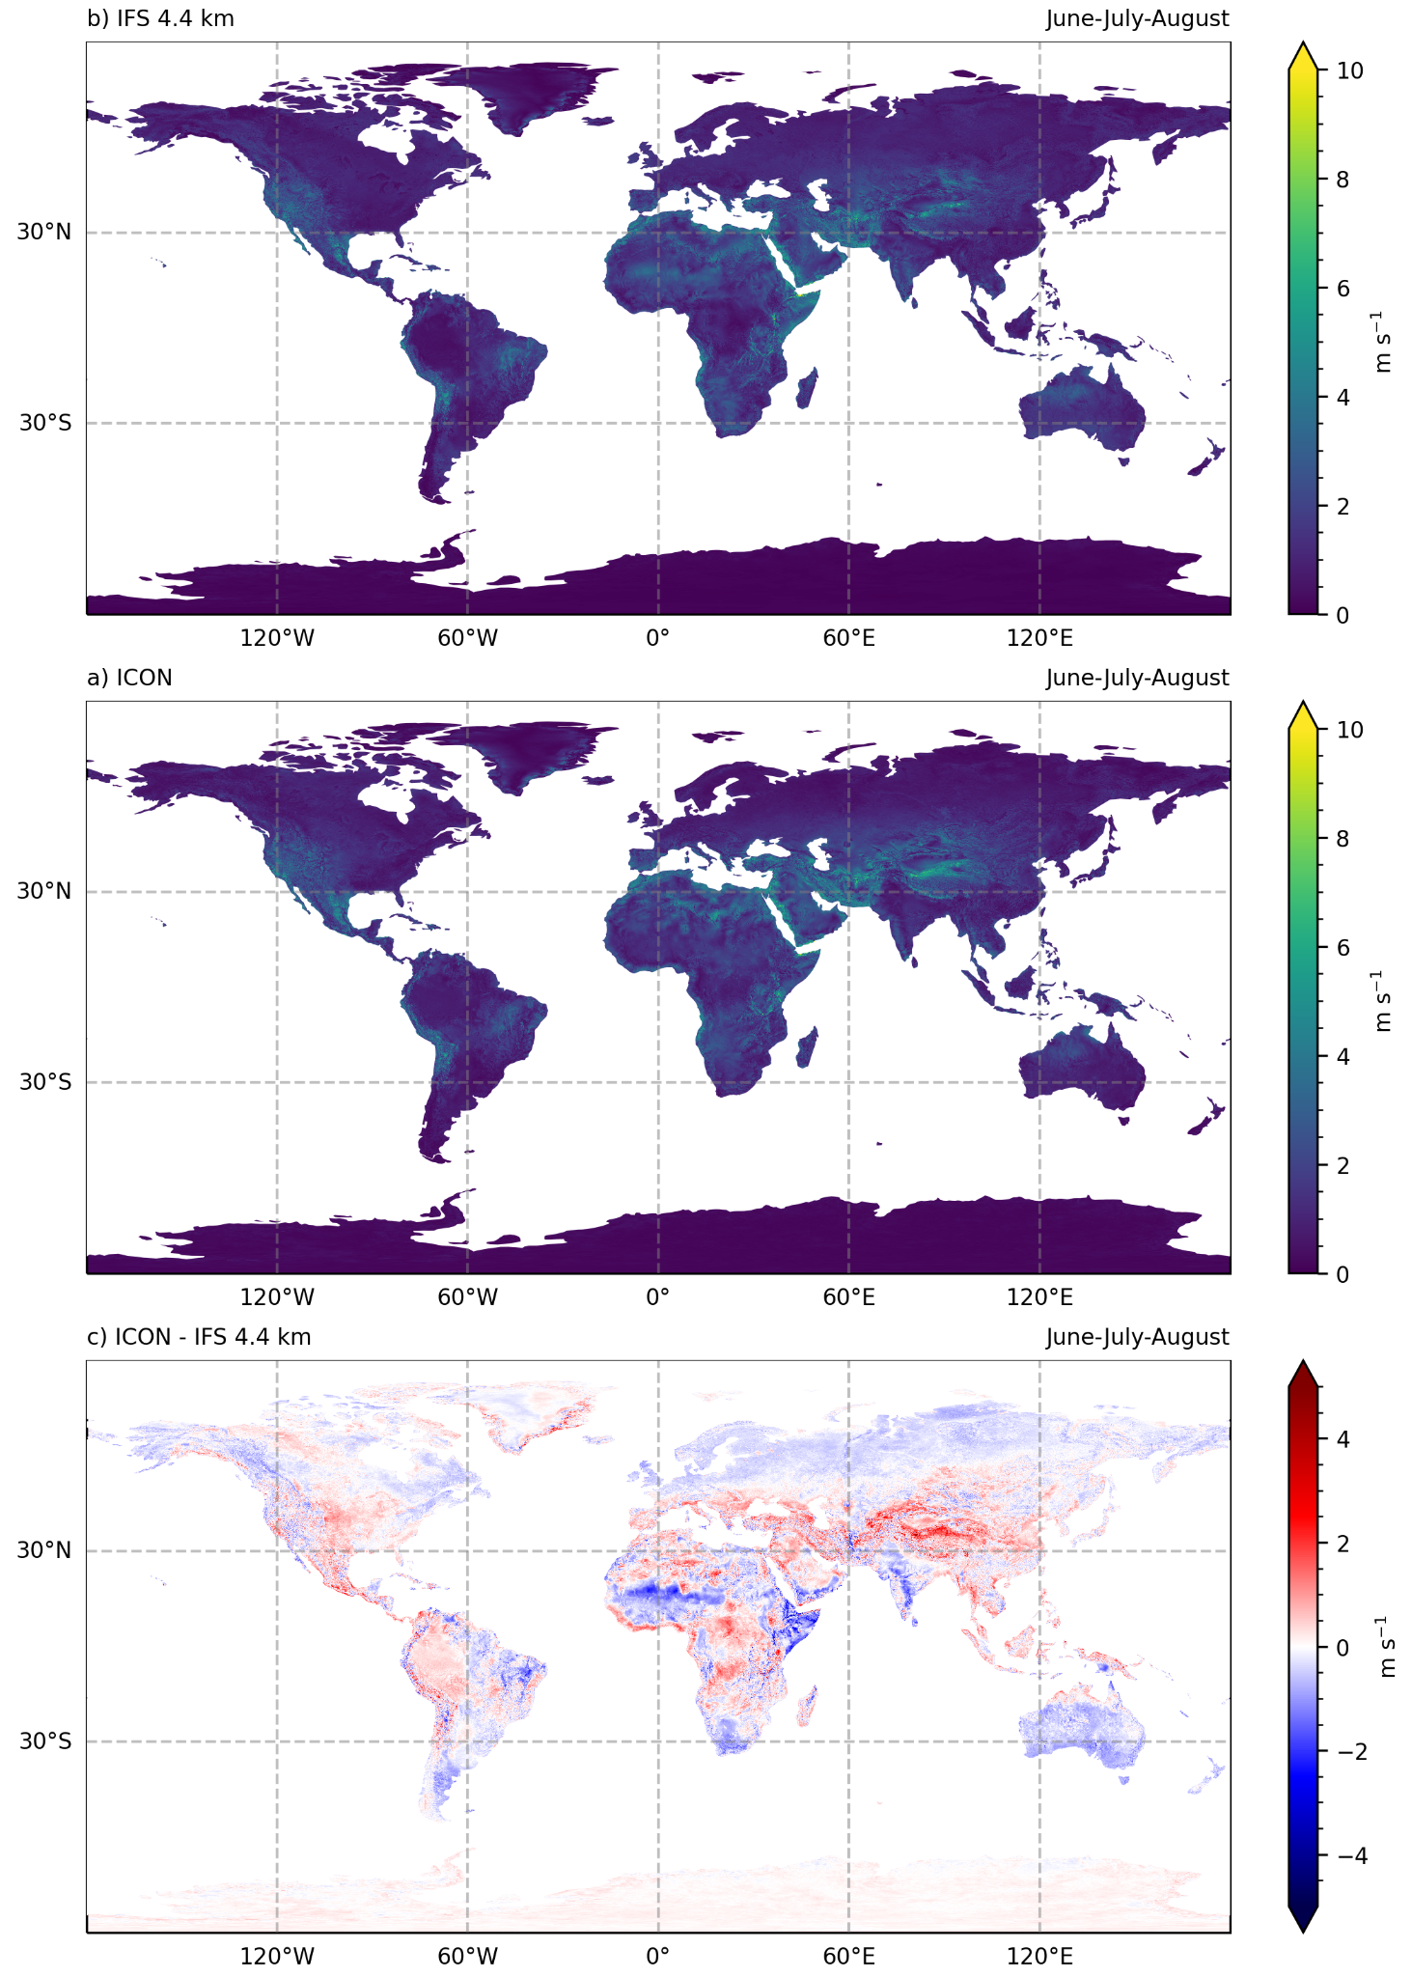
Range in mean diurnal cycle of wind speed in JJA
IFS 4.4
ICON - IFS 4.4
ICON

Slide 10
Cycle 4 results

Slide 11
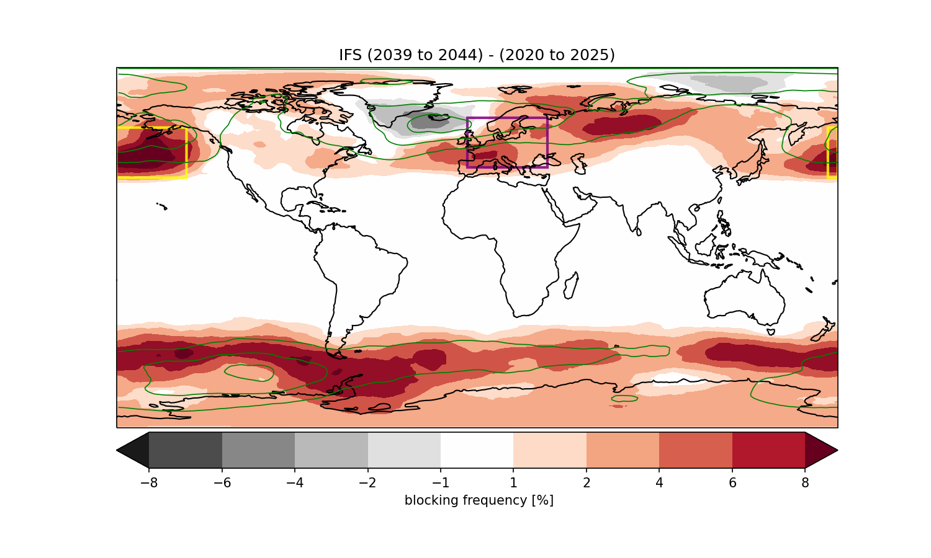
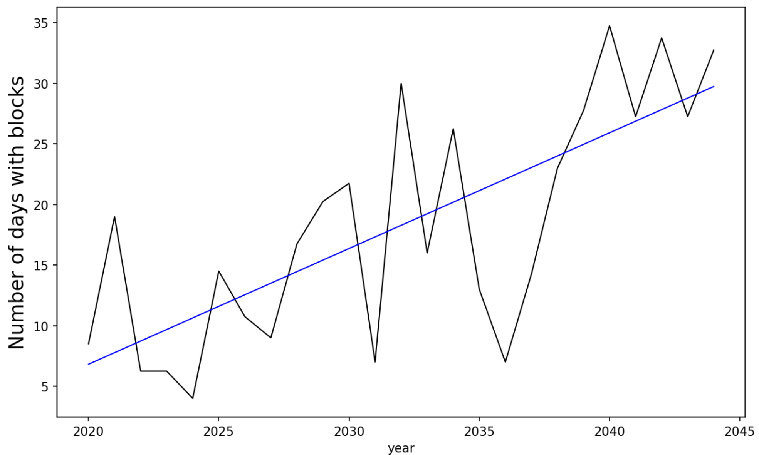
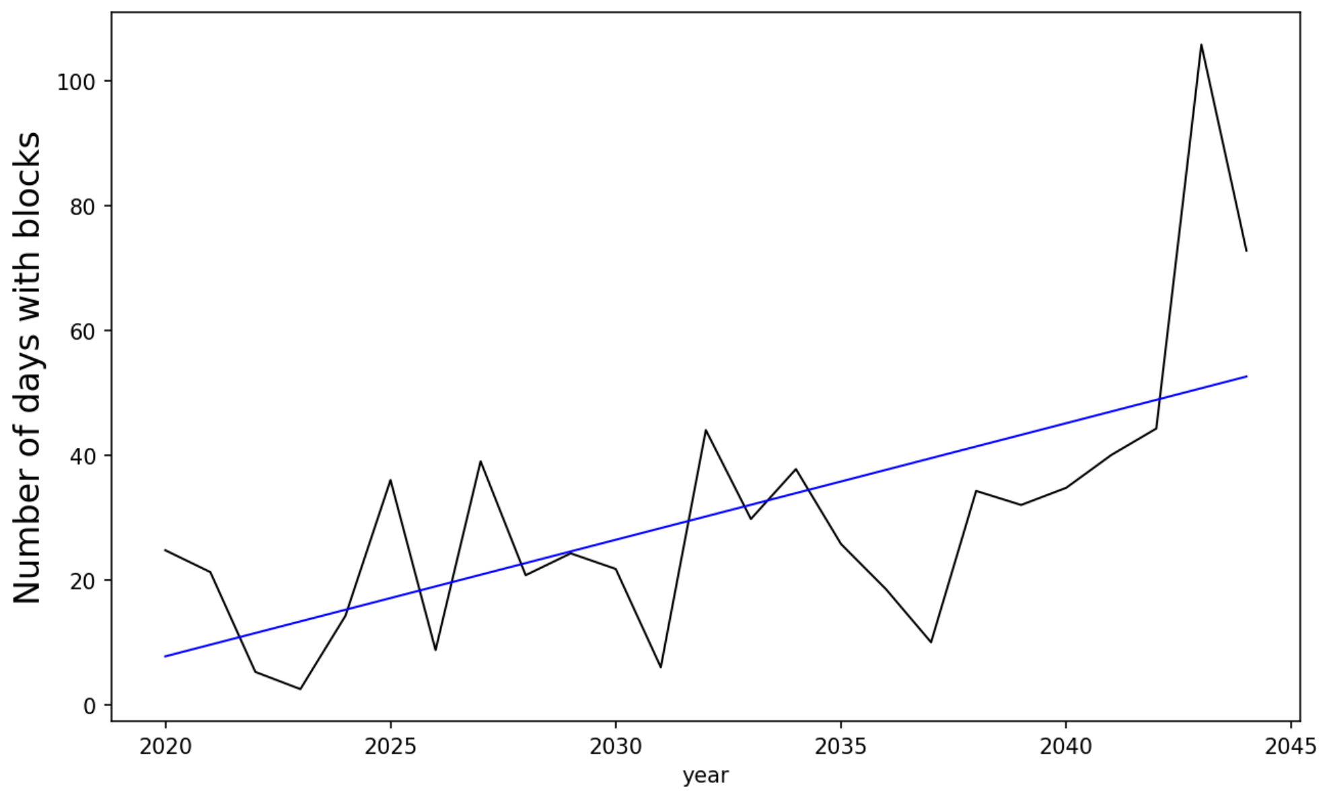
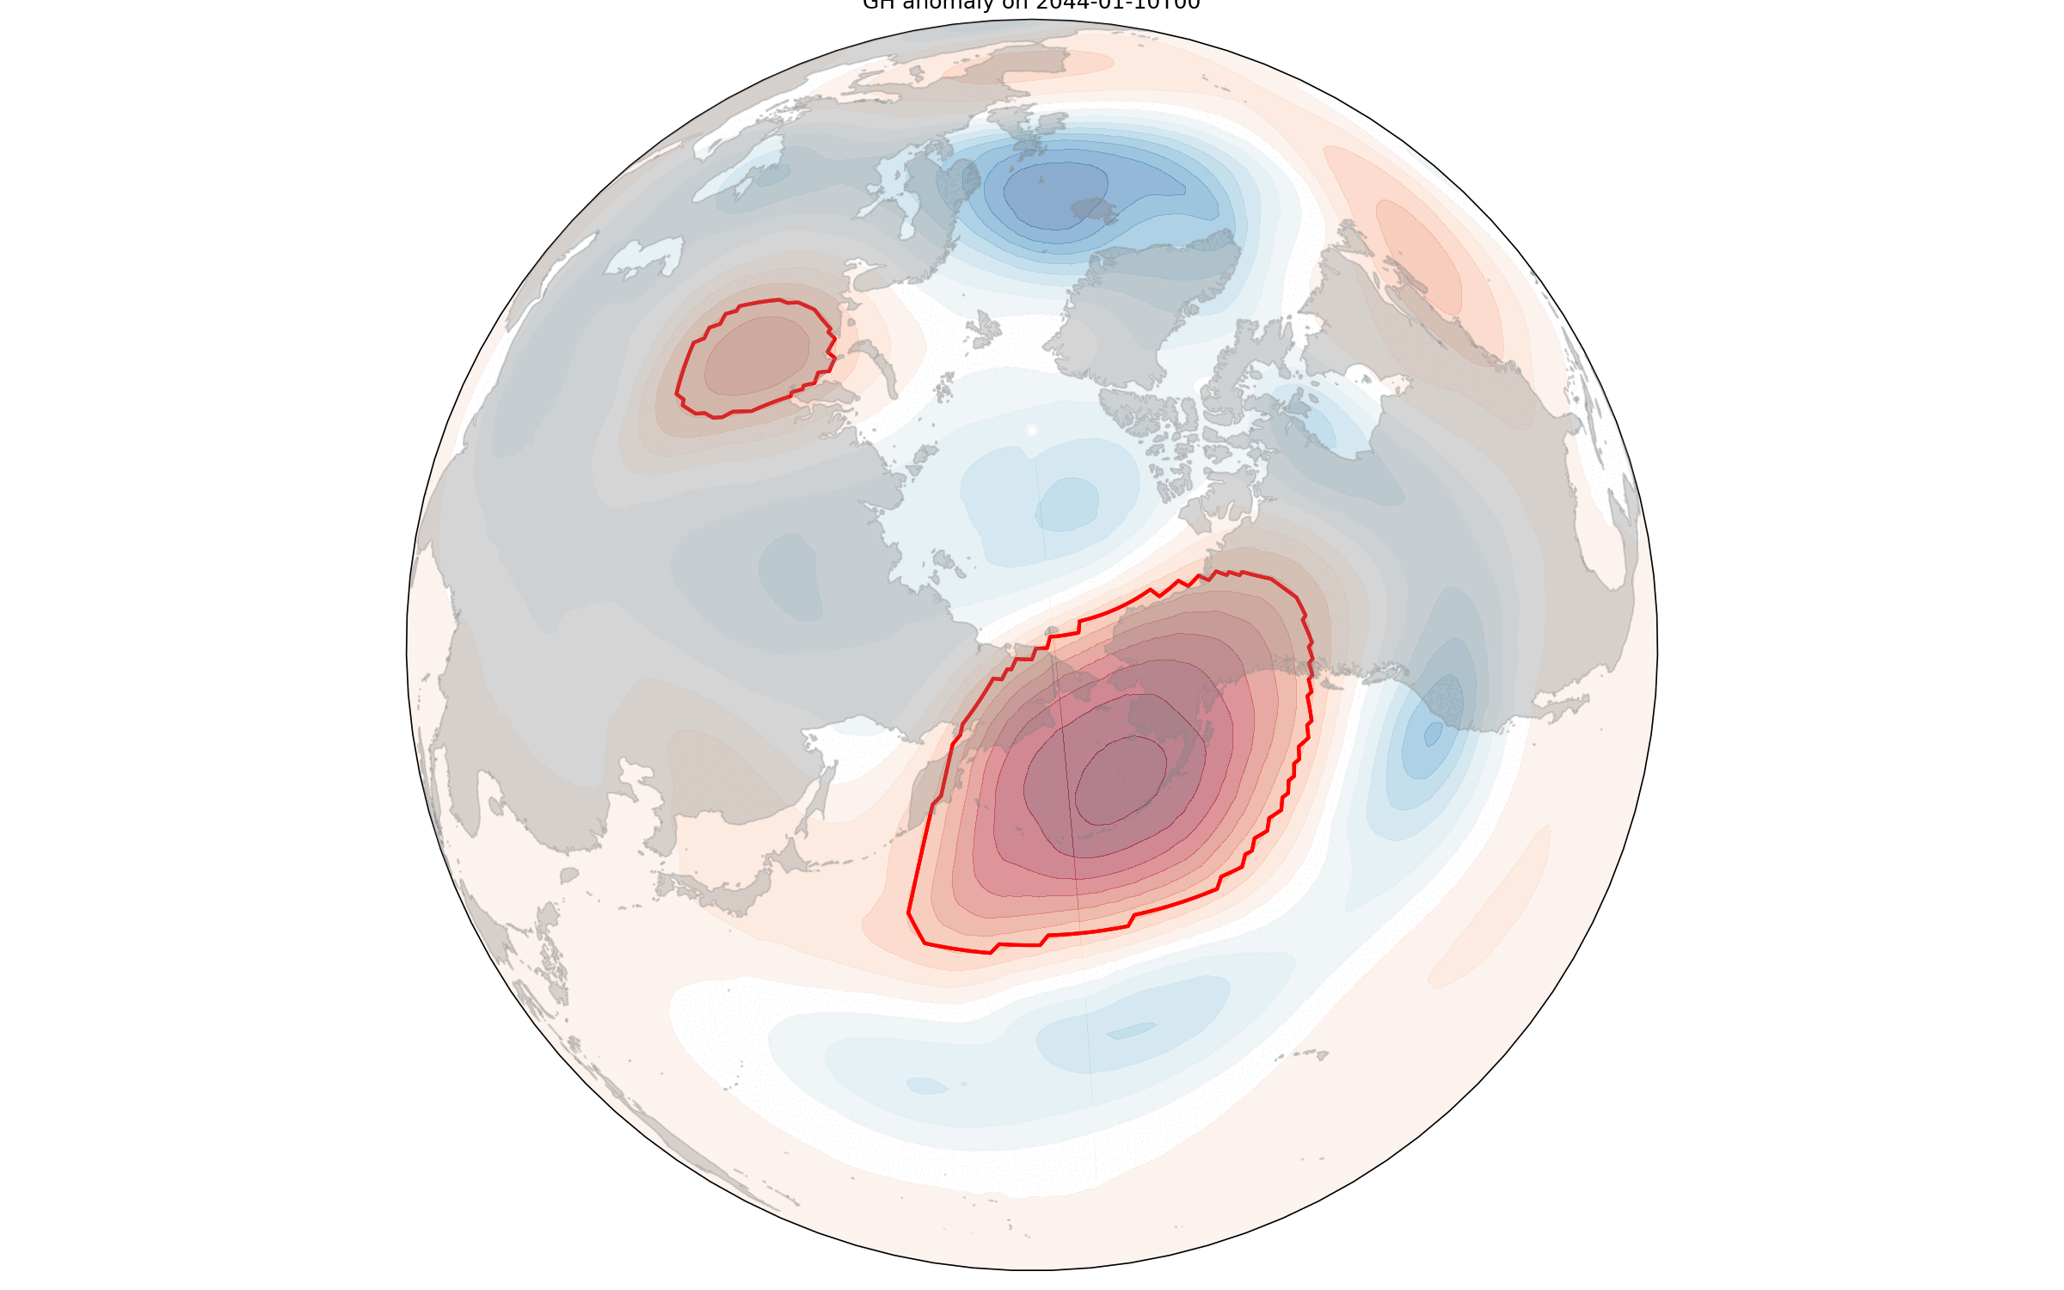
Changes in block frequency
Anomaly index
- 6-hourly data of geopotential height at 500 hpa
>=160 gmp anomaly, 70% overlap, 5-day persistence
Schwierz et al. (2004)

Slide 12
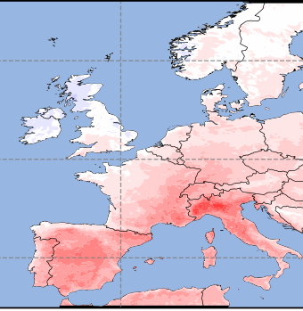
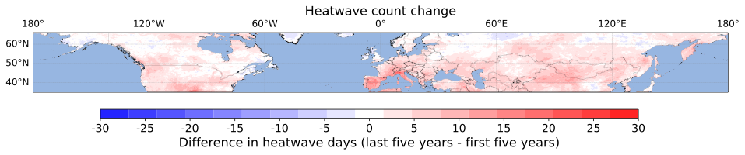
Heatwaves
Difference in total heatwave days. IFS (2039 to 2044) - (2020 to 2025)

Slide 13
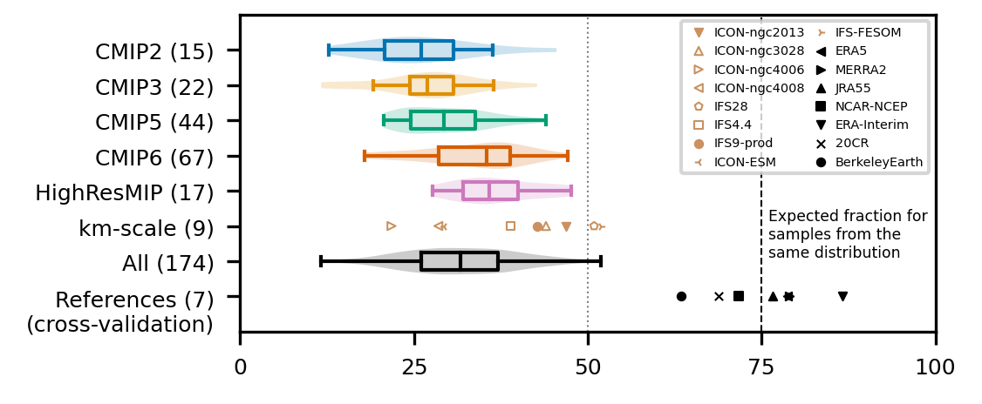
20-year global surface air temperature climatology: area inside observational uncertainty (%)
Notes:
Fraction of Earth's surface for which each model falls within the observational uncertainty range of the 20-year 2m surface air temperature climatology.
Additional details
CMIP models use the last 20 years of the pre-industrial control run, the other models use 1950 control or whatever is available.
The observational uncertainty range is based on 7 observational datasets as stated in the legend for the period 1980-1999.
The row with references shows a leave-one-out cross validation of each observation against the 6 others
Local linear trend over 20 years and global mean temperature is removed from each dataset separately.
Unfilled symbols indicate runs with less than 20 years available.
CMIP2 and CMIP3 include models with flux adjustment.

Slide 14
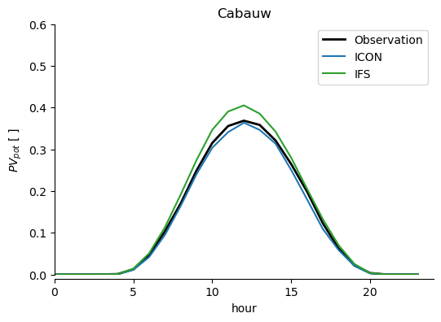
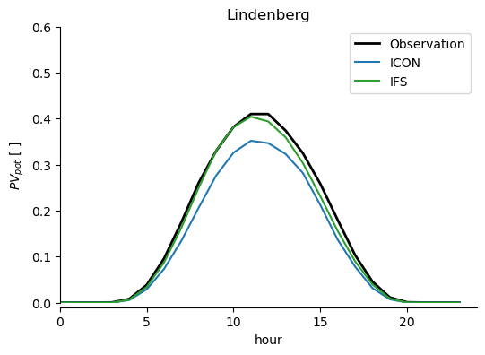
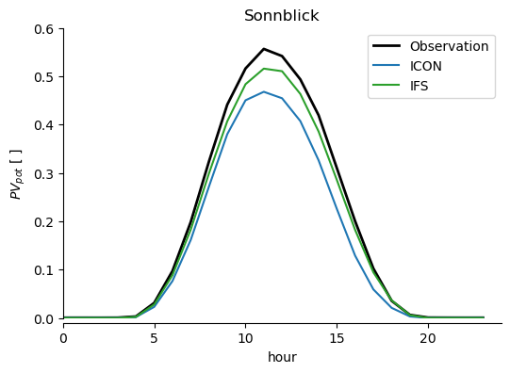
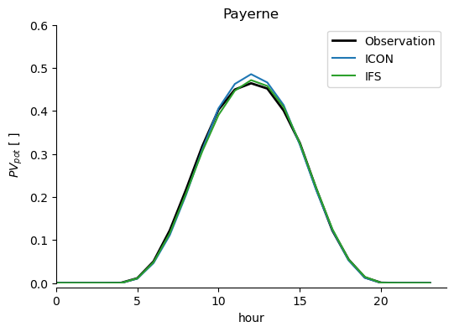
Photovoltaic power generation potential calculated from observational data and from models
Calculation for PVpot is following
Jerez, S., Tobin, I., Vautard, R. et al. The impact of climate change on photovoltaic power generation in Europe. Nat Commun 6, 10014 (2015). https://doi.org/10.1038/ncomms10014

Slide 15
Challenges
IFS and ICON data cannot be used in completely the same way
Temporal frequencies
Variable names
Variables
1st day is January 2nd
IFS slower to read in than ICON

Slide 16
Positives
30 years of data IFS
IFS & ICON both on healpix
Data access easy
Quality of IFS output seems very good
Overall more variables
Although some missing: e.g. IFS land sea mask
Information (pad, easygems, etc.) better organised
Nice visits to wind tunnel and DKRZ

Slide 17
Surprises
Short wave down in clear sky regions
Expected better global temperatures
Suprising region around Suriname/Guyana IFS 4.4 (compared to IFS 28 and ICON)
High Sensible Heat Flux High
High Diurnal Temperature Range
Not explained by radiation

Slide 18
Storms & Land
Cathy Hohenegger,
Chiel van Heerwaarden,
Sarah Warnau, Menno Veerman,
Edgar Dolores Tesillos, Junhong Lee,
Jonathan Wille, Kerstin Haslehner,
Josh Duffield, Lukas Brunner,
Emanuel Dutra
Hackathon Hamburg 2024

